Slide 1


SRM VALLIAMMAI ENGINEERING COLLEGE
AN AUTONOMOUS INSTITUTION
Approved by AICTE | Affiliated to Anna University | Accredited by NBA
‘A’ Grade Accreditation by NAAC | ISO 9001:2015 CERTIFIED
DEPARTMENT OF INFORMATION TECHNOLOGY
ACADEMIC YEAR 2022-2023(ODD SEMESTER)
INTERNSHIP TRAINING
ANDROID APPLICATION DEVELOPMENT
INTERNSHIP DONE IN:
DLK TECHNOLOGIES,
VADAPALANI, CHENNAI.
BALASUBRAMANIAN KALYAN
4th YEAR (ODD SEMESTER)
142219205012
IT-1

Slide 2
OUTLINE OF THE PRESENTATION
OBJECTIVE
SOFTWARE AND HARDWARE REQUIREMENTS
INTRODUCTION
OUTPUT
BENIFITS
ABOUT THE INDUSTRY
ARCHITECTURE DIAGRAM

Slide 3
ABOUT THE INDUSTRY
DLK Technologies Private Limited IT Solutions, headquartered in Chennai, India, is a HI-FI web development and digital marketing company who is excellent in the field of innovative website designing and Search Engine Optimization (SEO), Domain registration, Web Hosting, E-Commerce Solutions, Graphic Designing, Social Media Marketing, and other software related programs.
They are also offering powerful Search Engine Optimization Services & Creative Website Development with variety of CMS Technologies around the world.

Slide 4
OBJECTIVE
Explore career alternatives prior to graduation.
Integrate theory and practice.
Assess interests and abilities in their field of study.
Learn to appreciate work and its function in the economy.
Develop work habits and attitudes necessary for job success.
Develop communication, interpersonal and other critical skills in the job interview process.
Build a record of work experience.
To create a Android Application

Slide 5
OBJECTIVE
BMI CALCULATION
GENDER
HEIGHT
WEIGHT
AGE

Slide 6

ARCHITECTURE DIAGRAM
Activity_main.xml
Activity_splash.xml
MAIN ACTIVITY
BMI ACTIVITY
SPLASH SCREEN
APPLICATION ICON
Bmiactivity.xml
ic_launcher

Slide 7
HARDWARE REQUIREMENTS
Mobile device with Android 4.0 or above
SOFTWARE REQUIREMENTS
JAVA
Android Studio
Laptop/PC

Slide 8
BENIFITS
Can calculate the BMI value of any gender.
Height, Weight, Age are the main parameters and is enough to determine the BMI.
Shows the BMI level with signs such as warnings etc.,
BMI levels also shows the obese levels with their BMI number.
Xml and JAVA proficiency are increased.
APP opening/splash screen time is customizable.
Seekbar makes it easy to mark the height
Can also use Imageview(used as buttons) to take the values as inputs

Slide 9
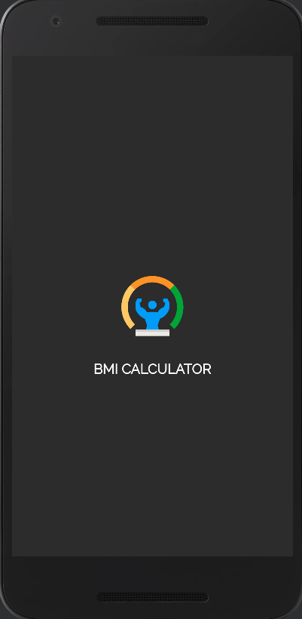
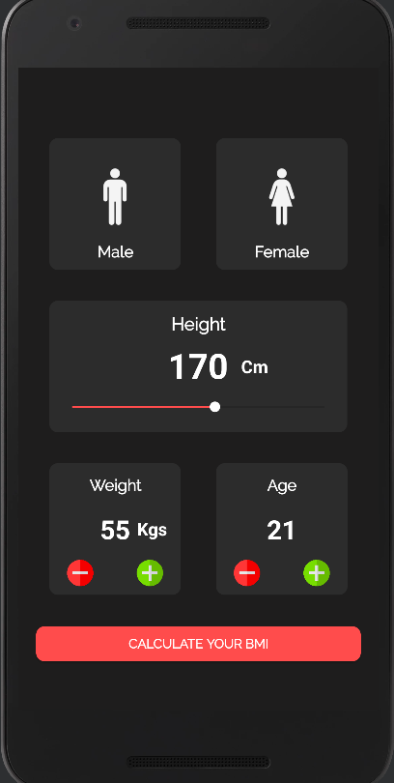
OUTPUTS
SPLASH SCREEN
Activity main

Slide 10
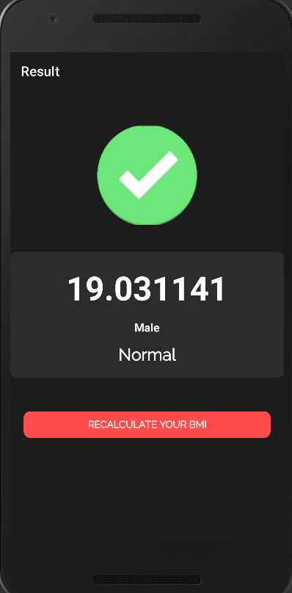
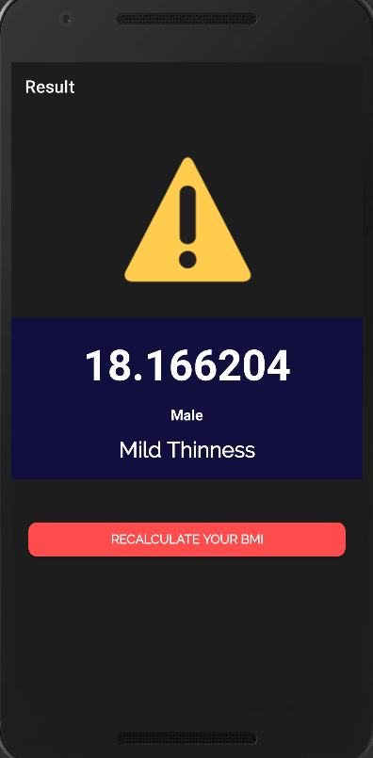
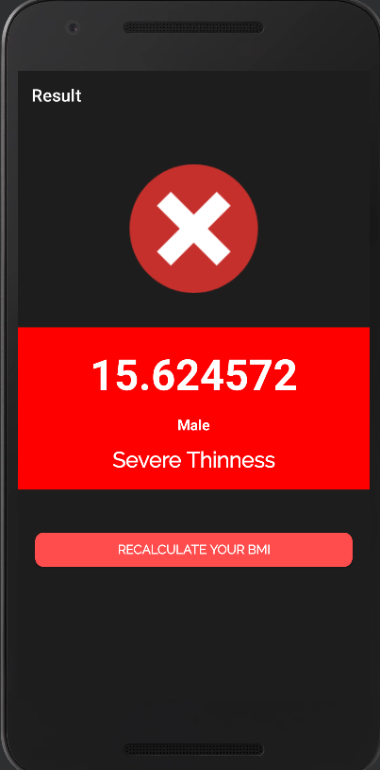
OUTPUTS

Slide 11

THANK YOU

